Slide 1



Income Effects on Food
How money changes our habits.
Notes:
Greetings.

Slide 2
Purchase Data Notes
One year of data
Club card users
Purchased items do not necessarily reflect consumption
Notes:
one year of data in 2015
Limitations assumptions Biases.

Slide 3
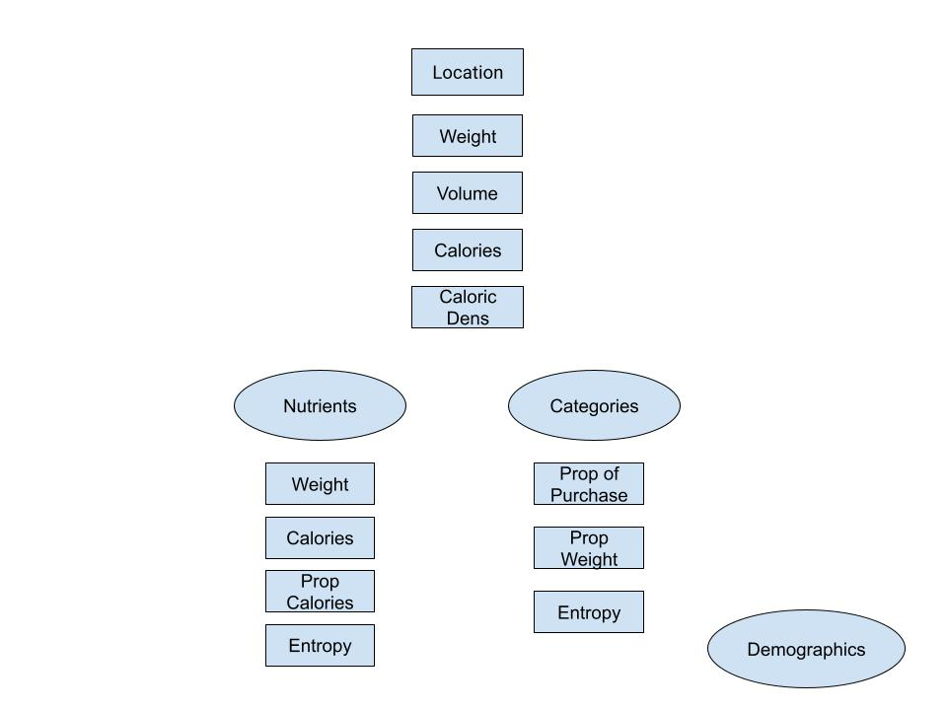
Purchase Data
Notes:
Each rectangle is a variable.
For each row of data....
nutrients e is calories and weight
cat e is e in categories and prop weight

Slide 4
Literature
Inferior and Normal Goods and income effects. Krugman and Wells (2018)
Seasonality of products can mirror Income effects. Scott (1995)
Notes:
Change in quantity demanded due to a change in income.
change in spending habits.

Slide 5
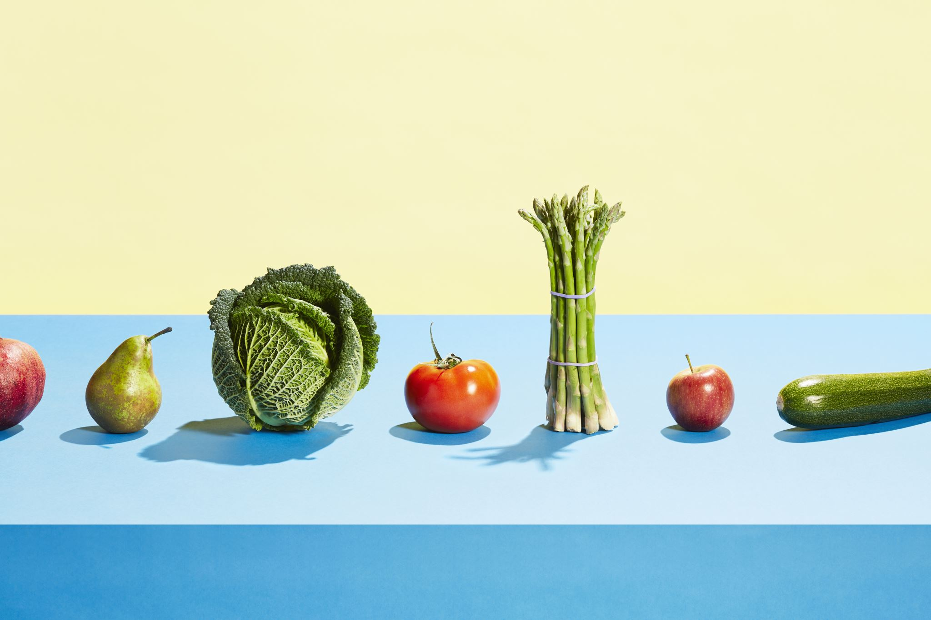
1. Seasonality in Nutrient Types
Notes:
Explore whether there's seasonality in Nutrient types.

Slide 6
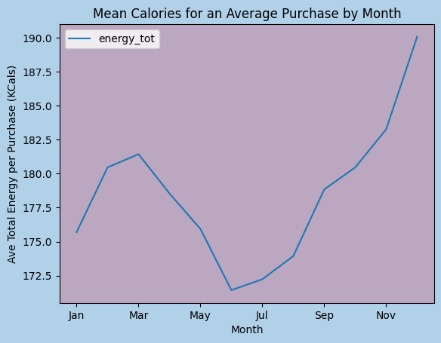
Seasonality by calories
Notes:
Average Calories by month in a typical purchase.

Slide 7
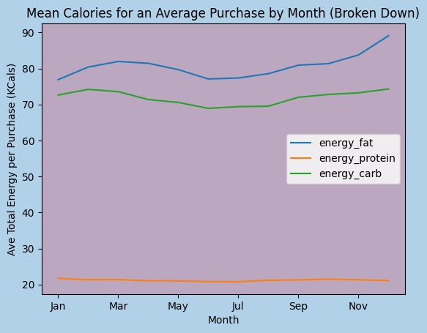
Seasonality by Calories
Notes:
Similar patterns found fats and carbs.

Slide 8
ANOVA
ANOVA uses the f-distribution to find differences in means separated by a category.
All three nutrient categories had at least one month where the mean calories purchased was different from the rest.
Fat – 70.7
Carbs – 5.0
Protein – 8.6
Notes:
category is month in this case

Slide 9
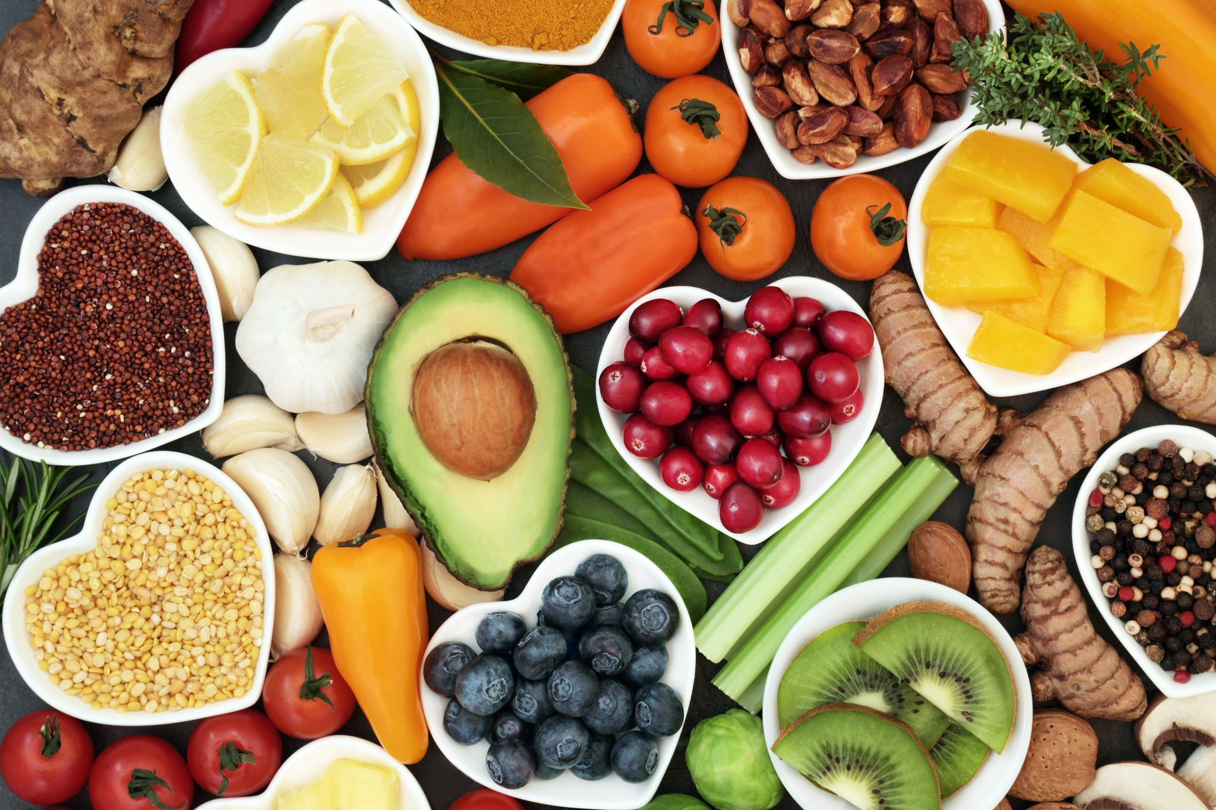
Seasonality in the proportion of a nutrient

Slide 10
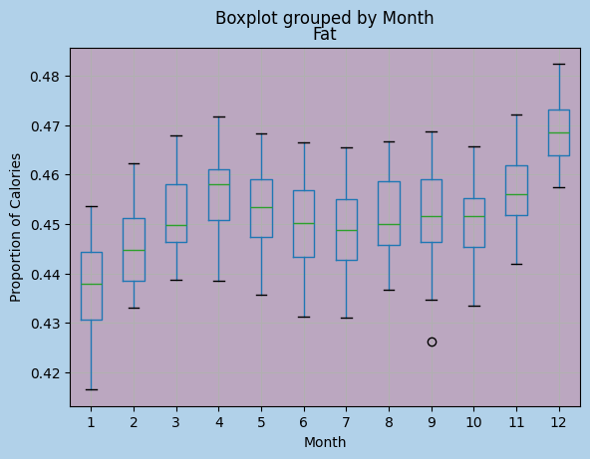
Seasonality of the Proportion of Fat in a purchase

Slide 11
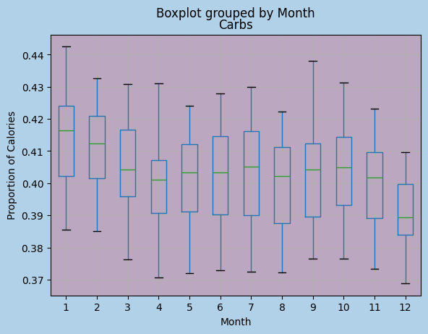
Seasonality of the Proportion of Carbs in a purchase

Slide 12
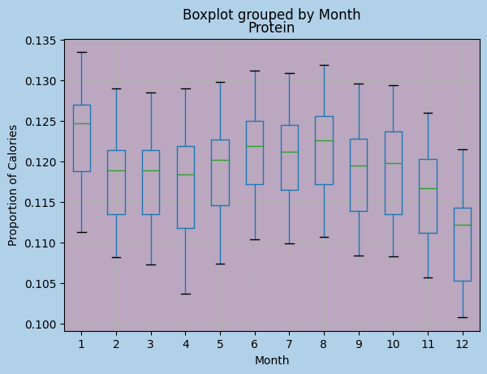
Seasonality of the Proportion of Protein in a purchase

Slide 13
ANOVA
Fat- F:24.2
Carbs-F:5.3
Protein-F:10.6
Notes:
In order to continue rb in analysis.
I perf an on the prop of the nutrient types in a purchase by month

Slide 14
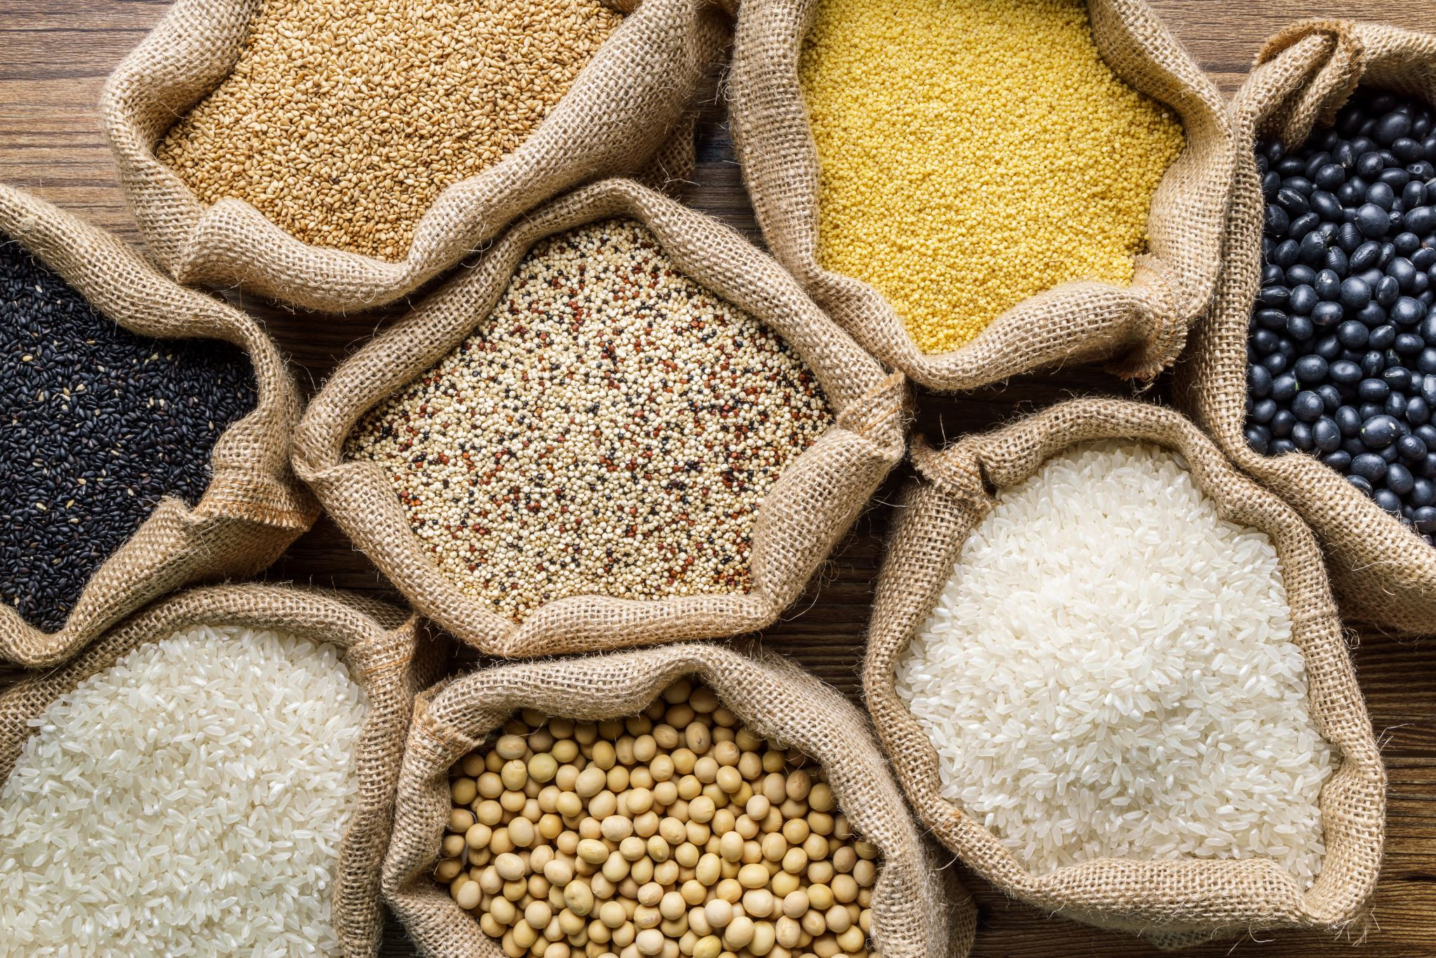
2. Seasonality of food categories

Slide 15
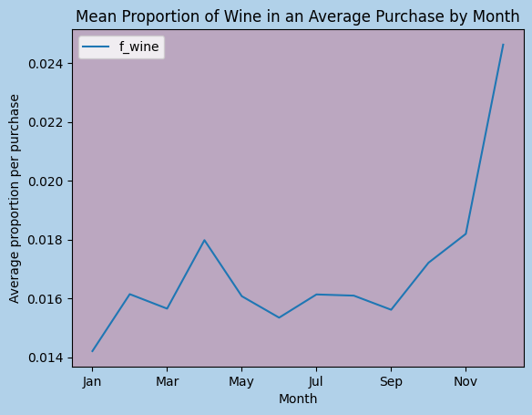
Wine
Proportion of wine in purchases pics up during holidays
F: 11.2
Normal good?
Notes:
Since we can assume that the propensity to spend might go up in the holidays, we might lead to believe that w is a normal good.

Slide 16
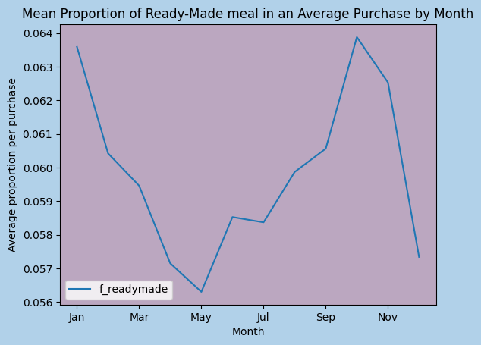
Ready made Meals
Proportions seem to decrease around holidays
differences in means not statistically significant
F: 1.2
P-val nov-Dec: 0.15
Effect size: 0.37
Income Effect?

Slide 17
Potential Income effects?
Evidence of seasonality could indicate income effects occurring.

Slide 18
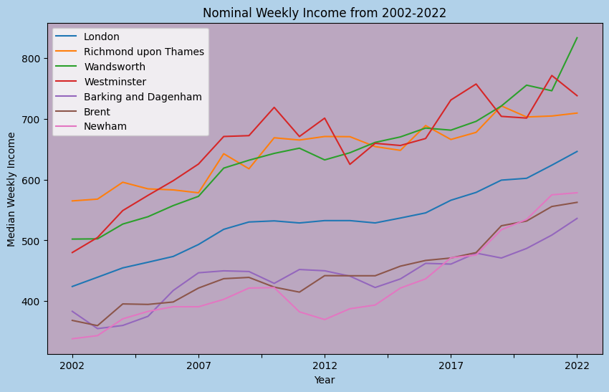
Income Data
ONS
Median Weekly Income by Borough
Top 3, bottom 3 in 2015.

Slide 19
Additional Literature
Xu et al (2020) found evidence that lower income families in China relied on carbs.

Slide 20
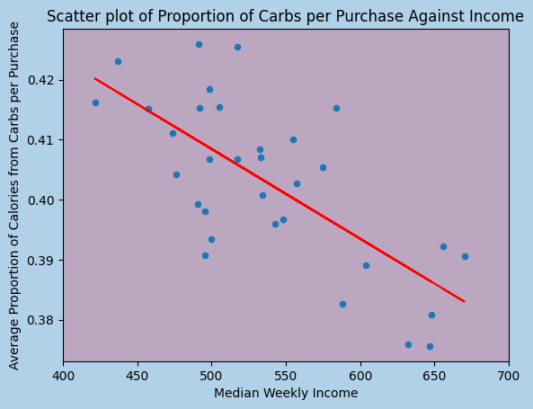
Carbs vs Income
Negative trend indicating inferior good.
Regression results stat significant
Adjusted R-Squared: 0.48
P-val: 0
Notes:
As income increases, proportion of carbs in purchases decreases indicating an inferior good.
regression results confirm statistical significance.

Slide 21
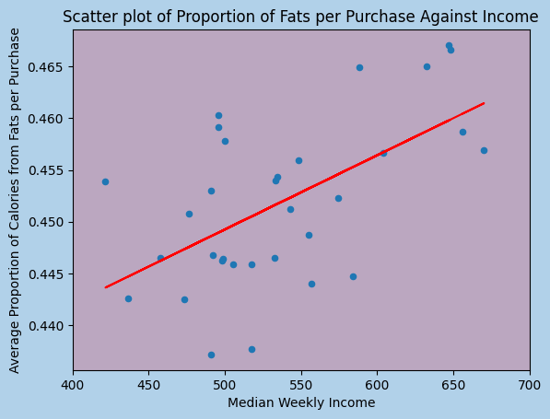
Fats vs Income
Positive linear trend indicating normal good
Regression results stat significant
Adjusted R-Squared: 0.31
P-Val: 0.001
Notes:
As income increases, proportion of fats in purchases increases indicating a normal good.
regression results confirm statistical significance.

Slide 22
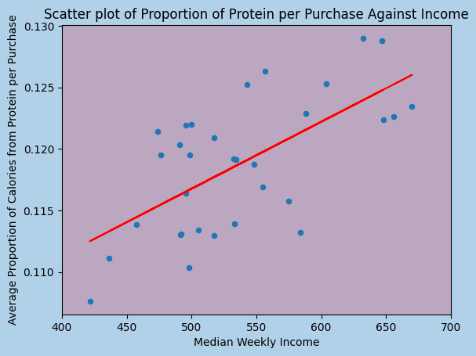
Protein vs Income
Positive linear trend indicating normal good
Regression results stat significant
Adjusted R-Squared: 0.4
P-Val: 0
Notes:
As income increases, proportion of protein in purchases increases indicating a normal good.
regression results confirm statistical significance.

Slide 23
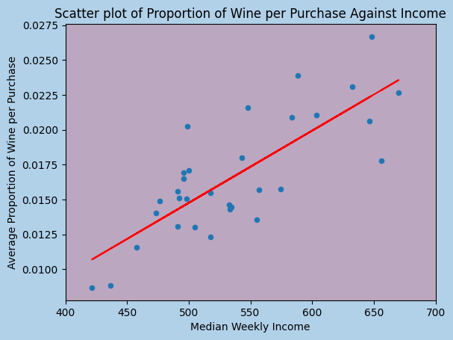
Wine vs Income
Positive linear trend indicating normal good
Regression results stat significant
Adjusted R-Squared: 0.61
P-Val: 0
Notes:
As income increases, proportion of wine in purchases increases indicating a normal good.
regression results confirm statistical significance.

Slide 24
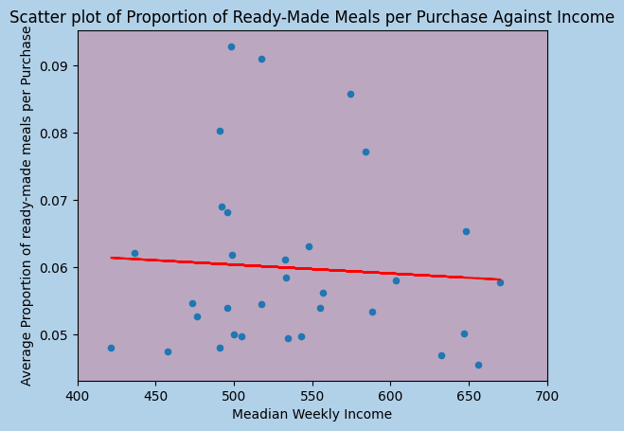
READYMADE vs Income
No trend observed. No evidence of an income effect.
Regression results stat insignificant
Adjusted R-Squared: -0.029
P-Val: 0.723
Notes:
On the other hand, we do not see any linear trend when it comes to ready made and income suggesting that there might not be an income effect at all.

Slide 25
Discussion and Conclusions
Fats –Normal good. Tasty. More expensive.
Protein - Normal good. Tasty. More expensive.
Carbs - Inferior good. Economic choices.
Wine - Normal good. Can be very expensive. Superfluous.
Ready Made - Anyone at anytime.

Slide 26
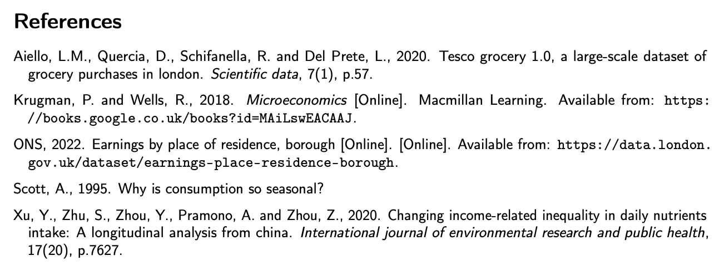
References

